Slide 1
MITIGATING COVID-19 FOR IOWA BUSINESSES AND ORGANIZATIONS
Frequently asked questions with answers
to assist Iowan’s with virus containment

Slide 2
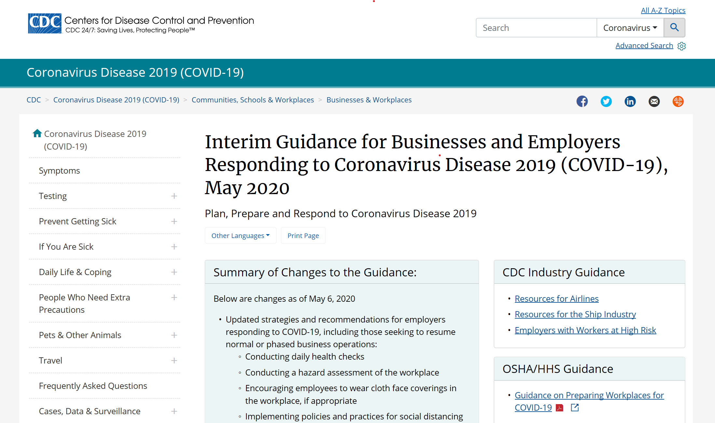
Preparedness: COVID-19 Business Assistance
l
https://www.cdc.gov/coronavirus/2019-ncov/community/guidance-business-response.html

Slide 3
Preparedness: Question: What can we do to mitigate potential COVID-19 exposure in our facility?
Answer:
Screening of employees: The Iowa Department of Public Health (IDPH) recommends posting signage at the facility entrance indicating no one should enter the establishment if they currently have symptoms or have been around anyone with a confirmed COVID-19 diagnosis in the last 14 days.
Conducting temperature scans of employees at facility entrances
Encouraging social distancing/increased spacing between workers
Using face coverings, the Centers for Disease Control and Prevention (CDC) recommends face coverings in the workplace, especially for those employees that are not able to maintain proper social distancing.
Changing employee schedules and company layout, shift changes, additions or variations to assist in spreading out your employees
Staggering of employee breaks to limit employee interaction
Providing handwashing stations/hand sanitizer, face coverings or PPEs or encouraging employees to use masks
Increasing ventilation in the facility
Installing physical barriers, like plastic sneeze guards
Ensuring leave policies are flexible
Encouraging sick employees to stay home
Conducting COVID-19 education of employees on risk factors and protective behavior
Communicating all information in native languages of all employees
Continuous cleaning and sanitizing of common areas of the facility (restrooms, locker rooms, break or cafeteria space)

Slide 4
Testing: Question: Who should be tested for COVID-19?
Answer:
Any Iowan can be tested for current infection with COVID-19 through Test Iowa www.testiowa.com
Serology testing can determine whether a person was likely previously infected with COVID-19 for additional information about testing visit: https://idph.iowa.gov/Portals/1/userfiles/61/covid19/COVID%2019%20Testing%20Framework%2005_27_20.pdf

Slide 5
Testing: Question: Our business has multiple employees that recently have tested positive for COVID-19. What testing options are available for our employees to prevent further spread of the virus?
Answer:
Iowa businesses wanting to perform PCR or serology testing, in accordance with the State Hygienic Laboratory (SHL) testing criteria, should arrange testing for their staff through their occupational health provider and send specimens to SHL for testing. Or direct staff to pursue testing through Test Iowa.
Iowa businesses wanting to perform PCR or serology testing outside of the SHL testing criteria should arrange testing for their staff in coordination with their occupational health provider using a clinical or commercial laboratory. The cost of this testing is the responsibility of the business or the employee. Occupational health providers may identify a local clinical laboratory performing COVID-19 testing. Different test assays may have different collection methods and/or performance characteristics. A list of commercial laboratories performing COVID-19 testing is available here: https://www.fda.gov/medical-devices/emergency-situations-medical-devices/emergency-use-authorizations#coronavirus2019 (scroll down to “Test Kit Manufacturers and Commercial Laboratories Table”).

Slide 6
Testing: Question: How do I interpret my COVID-19 test results?

Slide 7
Business Operations: Question: Do you have recommendations for cleaning a facility after a COVID-19 positive case has been identified in a facility/business?
Answer:
Clean
Wear disposable gloves to clean and disinfect.
Clean surfaces using soap and water, then use disinfectant.
Cleaning with soap and water reduces number of germs, dirt and impurities on the surface.
Disinfecting kills germs on surfaces.
Practice routine cleaning of frequently touched surfaces.
More frequent cleaning and disinfection may be required based on level of use.
Surfaces and objects in public places, such as shopping carts and point of sale keypads should be cleaned and disinfected before each use.
High touch surfaces include:
Tables, doorknobs, light switches, countertops, handles, desks, phones, keyboards, toilets, faucets, sinks, etc.
Disinfect
Recommend use of EPA-registered household disinfectant external icon. Follow the instructions on the label to ensure safe and effective use of the product. Many products recommend:
Keeping surface wet for a period of time (see product label).
Precautions such as wearing gloves and making sure you have good ventilation during use of the product.
https://www.cdc.gov/coronavirus/2019-ncov/community/disinfecting-building-facility.html

Slide 8
Business Operations: Question: Are businesses required to report positive COVID-19 cases to the government?
Answer:
No, businesses are not required to report cases to the government. Laboratory results are communicated to the patient and the provider who ordered them. They are required by law to be reported by the lab to public health. Public health performs case investigation follow-up and reinforces isolation and quarantine recommendations and has the legal authority to share information on positive cases with businesses when it is necessary for an investigation.
Individuals who do not comply with public health isolation and quarantine recommendations may be subject to locally issued legally enforceable orders.
If a business has concern about a specific situation, they are encouraged to contact their local public health department.

Slide 9
Business Operations: Question: We have an employee whose spouse works in a senior care facility that has reported a positive COVID-19 case. What is the appropriate course of action for our company?
Answer:
If the spouse is ill with COVID-19 symptoms and your employee has been in close contact (defined as being with 6 feet for more than 15 minutes) from 48 hours before the spouse got sick until 10 days from when her illness began) your employee should self-isolate for 14 days after his last day of contact. If the spouse is well and has tested negative there is not a need for him to self-isolate at this point.

Slide 10
Business Operations: Question: We have an employee that was in close contact with a COVID-19 Positive case and they themselves have tested negative. Can they return to work or do they need to self-quarantine for the entire 14 days from date of last exposure?
Answer:
Our recommendation is to self-quarantine for 14 days after close contact with a confirmed case. The negative test is just a point in time, so the person could be positive tomorrow. Also asymptomatic people can spread the virus. Therefore they must quarantine for a full 14 days unless a critical worker in which case they need to follow critical worker guidance.
https://www.sciencedaily.com/releases/2020/05/200526173832.htm

Slide 11
Business Operations: Question: Are businesses required to inform fellow employees of positive COVID cases within their business?
Answer:
It would be best practice to notify other personnel in the office that had close contact with the exposed person - but we do not recommend mass notification with name of infected person. Close contacts should also be identified during the case investigation.

Slide 12
Business Operations: Question: Will it violate HIPAA to clean the workstation of an employee who tested positive.
Answer:
If possible, the workstation should be cleaned after hours to decrease the chances of identifying the employee who tested positive. The cleaning should also focus on frequently touched areas and shared spaces.

Slide 13
Business Operations: Question: When is the start date of the 10 days for isolation for a positive COVID-19 test? Is it the start date when the test was first completed, or when the positive result was emailed?
Answer:
The start date is the day of the test (not the day that results were released).

Slide 14
Business Operations: I have an employee who has tested positive for COVID-19. When can this employee return to work?
Answer:
According to the CDC people are no longer considered contagious if:
At least 10 days have passed since symptoms first appeared, and
At least 1 day (24 hours) has passed since recovery defined as resolution of fever without the use of fever-reducing medications and with improved symptoms (e.g., cough, shortness of breath).

Slide 15
Business Operations: Question: Are there any recommendations for business/company travel?
Answer:
Updated travel related guidance for COVID-19
COVID-19 virus is circulating across the United States. While there is no longer a recommendation to self-isolate for 14 days after returning home from travel outside of Iowa and within the United States (as long as the traveler remains well and has not been identified as a close contact of an ill individual), travelers should continue to:
Clean your hands often.
Wash your hands often with soap and water for at least 20 seconds especially after you have been in a public place, or after blowing your nose, coughing, or sneezing. If soap and water are not readily available, use the hand sanitizer that contains at least 60% alcohol. Cover all surfaces of your hands and rub your hands together until they feel dry.
Avoid touching your eyes, nose, and mouth.
Avoid close contact with others.
Keep 6 feet of physical distance from others.
Avoiding close contact is especially important if you are at higher risk of getting sick from COVID-19.
Wear a cloth face covering in public.
Cover coughs and sneezes.
The Centers for Disease Control and Prevention continues to recommend that person is returning from international travel self-quarantine for 14 days after they return.
Do not travel if you are sick.

Slide 16
Regulatory: Question: Do I have to record or report positive COVID-19 cases involving my employees?
Answer:
Under OSHA’s recordkeeping requirements, COVID-19 is a recordable illness, and employers are responsible for recording cases of COVID-19, if: (1) the case is a confirmed case of COVID-19, as defined by Centers for Disease Control and Prevention (2) the case is work-related as defined by 29 CFR § 1904.5 and (3) the case involves one or more of the general recording criteria set forth in 1904.7.
April 10, 2020 Recordkeeping Memorandum

Slide 17
Regulatory: Question: Do I have to reopen if my work environment will not meet CDC guidelines with the six feet of social distancing?
Answer:
An employer is not required to reopen. If the employer cannot meet the recommended guidelines per CDC, Iowa Department of Public Health, Governor's Proclamation of Disaster Emergency, or OSHA COVID-19 guidance, such as social distancing, it would be ill advised to reopen.
Proclamation of Disaster Emergency

Slide 18
Regulatory: Question: What will the employer need to do when providing N95 masks to employees? Is OSHA waiving the regulations?
Answer:
All employers whose employees are required to use or are permitted voluntary use of respiratory protection must continue to manage their respiratory protection programs (RPPs) in accordance with the OSHA respirator standard, and should pay close attention to shortages of N95s during the COVID-19 pandemic (additional information www.iowaosha.gov)
OSHA 4015 respirator poster

Slide 19
Regulatory: Question: What constitutes a workplace shutdown?
Answer:
There are no requirements at this time for a business shutdown following positive COVID-19 test results. That would be left up to the employer to determine if a shutdown is warranted. Employers should develop contingency plans for operating their businesses with fewer employees due to some workers being isolated or quarantined.

Slide 20
Regulatory: Question: Are businesses required to supply masks, Clorox Wipes, etc. to keep their employees safe and what rights do the employees have if the business is not providing measures.
Answer:
Employers have an obligation to ensure a safe and healthy workplace. Employers may choose to ensure that cloth face coverings are worn as a feasible means of abatement in a control plan designed to address hazards from SARS-CoV-2, the virus that causes COVID-19. Employers may choose to use cloth face coverings as a means of source control of transmission risk that cannot be controlled through engineering or administrative controls, including social distancing. There is no standard or regulation for cloth face masks. If an employer requires N95 filtering facepiece respirators as part of the employee's personal protective equipment, a cloth or surgical mask is not sufficient. For sanitation, the employer must furnish a place of employment that is kept clean to the extent that the nature of the work allows. Lavatories must include hand soap or similar cleansing agents and individual hand towels. When employees are exposed to hazardous chemicals the employer must follow the manufacturer's instructions. If an employee has concerns regarding their workplace safety and/or health, they may contact Iowa OSHA at 515-725-5621 or www.iowaosha.gov.
This link will provide the 10 steps all Workplaces can take to reduce the risk of exposure to Coronavirus: https://www.osha.gov/Publications/OSHA3994.pdf

Slide 21
Mass Gatherings: Question: What are the guidelines for youth sporting events?
Answer:
The gathering organizer must ensure social distancing, which is defined as at least six feet of physical distance between each group or individual attending alone. Practices, games, and competitions for baseball, softball, and individual sports, such as running, bicycling, swimming, tennis, and golf, are not prohibited, even where athletes may have some contact within six feet, provided that the organizer of such activities and events implements reasonable measures under the circumstances of each gathering to ensure reasonable social distancing, increased hygiene practices, and other public health measures to reduce the risk of transmission of COVID-19 consistent with guidance issued by the Iowa Department of Public Health. Please refer to the Governor’s Public Health proclamation of June 10, 2020 for additional information: https://governor.iowa.gov/sites/default/files/documents/Public%20Health%20Proclamation%20-%202020.06.10.pdf

Slide 22
Mass Gatherings: Question: Can we hold our annual festival – including indoor and outdoor activities?
Answer:
Yes, a festival may be held if it complies with all relevant provisions in the Governor’s Public Health proclamation of June 10, 2020. In particular, the gathering organizer must ensure social distancing, which is defined as at least six feet of physical distance between each group or individual attending alone social distancing. Additionally, the gathering organizer shall also implement reasonable measures for increased hygiene practices, and other public health measures to reduce the risk of transmission of COVID-19 consistent with guidance issued by the Iowa Department of Public Health and, for any food service, the Iowa Department of Inspections and Appeals. Please refer to the Governor’s Public Health proclamation of June 10, 2020 for additional information: https://governor.iowa.gov/sites/default/files/documents/Public%20Health%20Proclamation%20-%202020.06.10.pdf

Slide 23
Miscellaneous Questions: Question: In my community there is a restaurant that is not following the proper COVID-19 protocols for social distancing as designated by the state of Iowa. Who do I call to report potential violations?
Answer:
Contact local and/or state law enforcement officials who govern state emergency protocols issued by the Governor for the state of Iowa.
If the establishment not following state protocols holds a liquor license, the Iowa Alcoholic Beverages Division can be contacted to begin a formal investigation as all licensees must follow all local, state and federal laws including local ordinances and state issued proclamations.

Slide 24
Additional Resources:
State of Iowa: https://coronavirus.iowa.gov/
Iowa Department of Public Health: IDPH procedures
IDPH pdf
IDPH COVID-19
https://idph.iowa.gov/Emerging-Health-Issues/Novel-Coronavirus/Business-and-Organizations
Centers of Disease Control and Prevention: CDC COVID-19 business response
Occupational Safety and Health Administration: OSHA publication 3990
OSHA Publication 3994
News release
News release
www.iowaosha.gov
Iowa Economic Development Authority; https://www.iowaeconomicdevelopment.com/covid-19/
Department of Human Services; DHS Childcare
Dental Board; Iowa Dental Board

Slide 25
Contact Information:
For additional COVID-19 guidance or consultation for Iowa businesses contact
covid19business@iowa.gov

